Slide 1
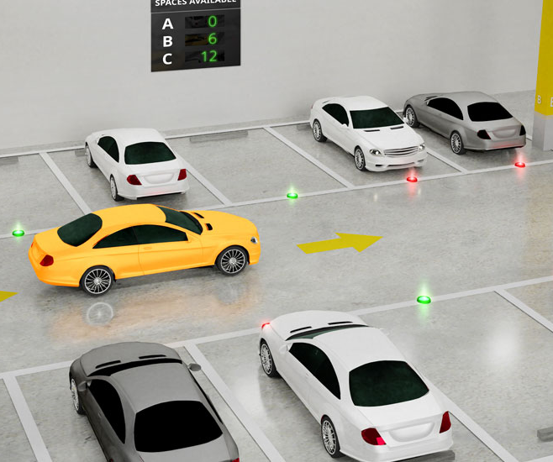
Smart Car Parking
Niharika Singh, 21095078

Slide 2

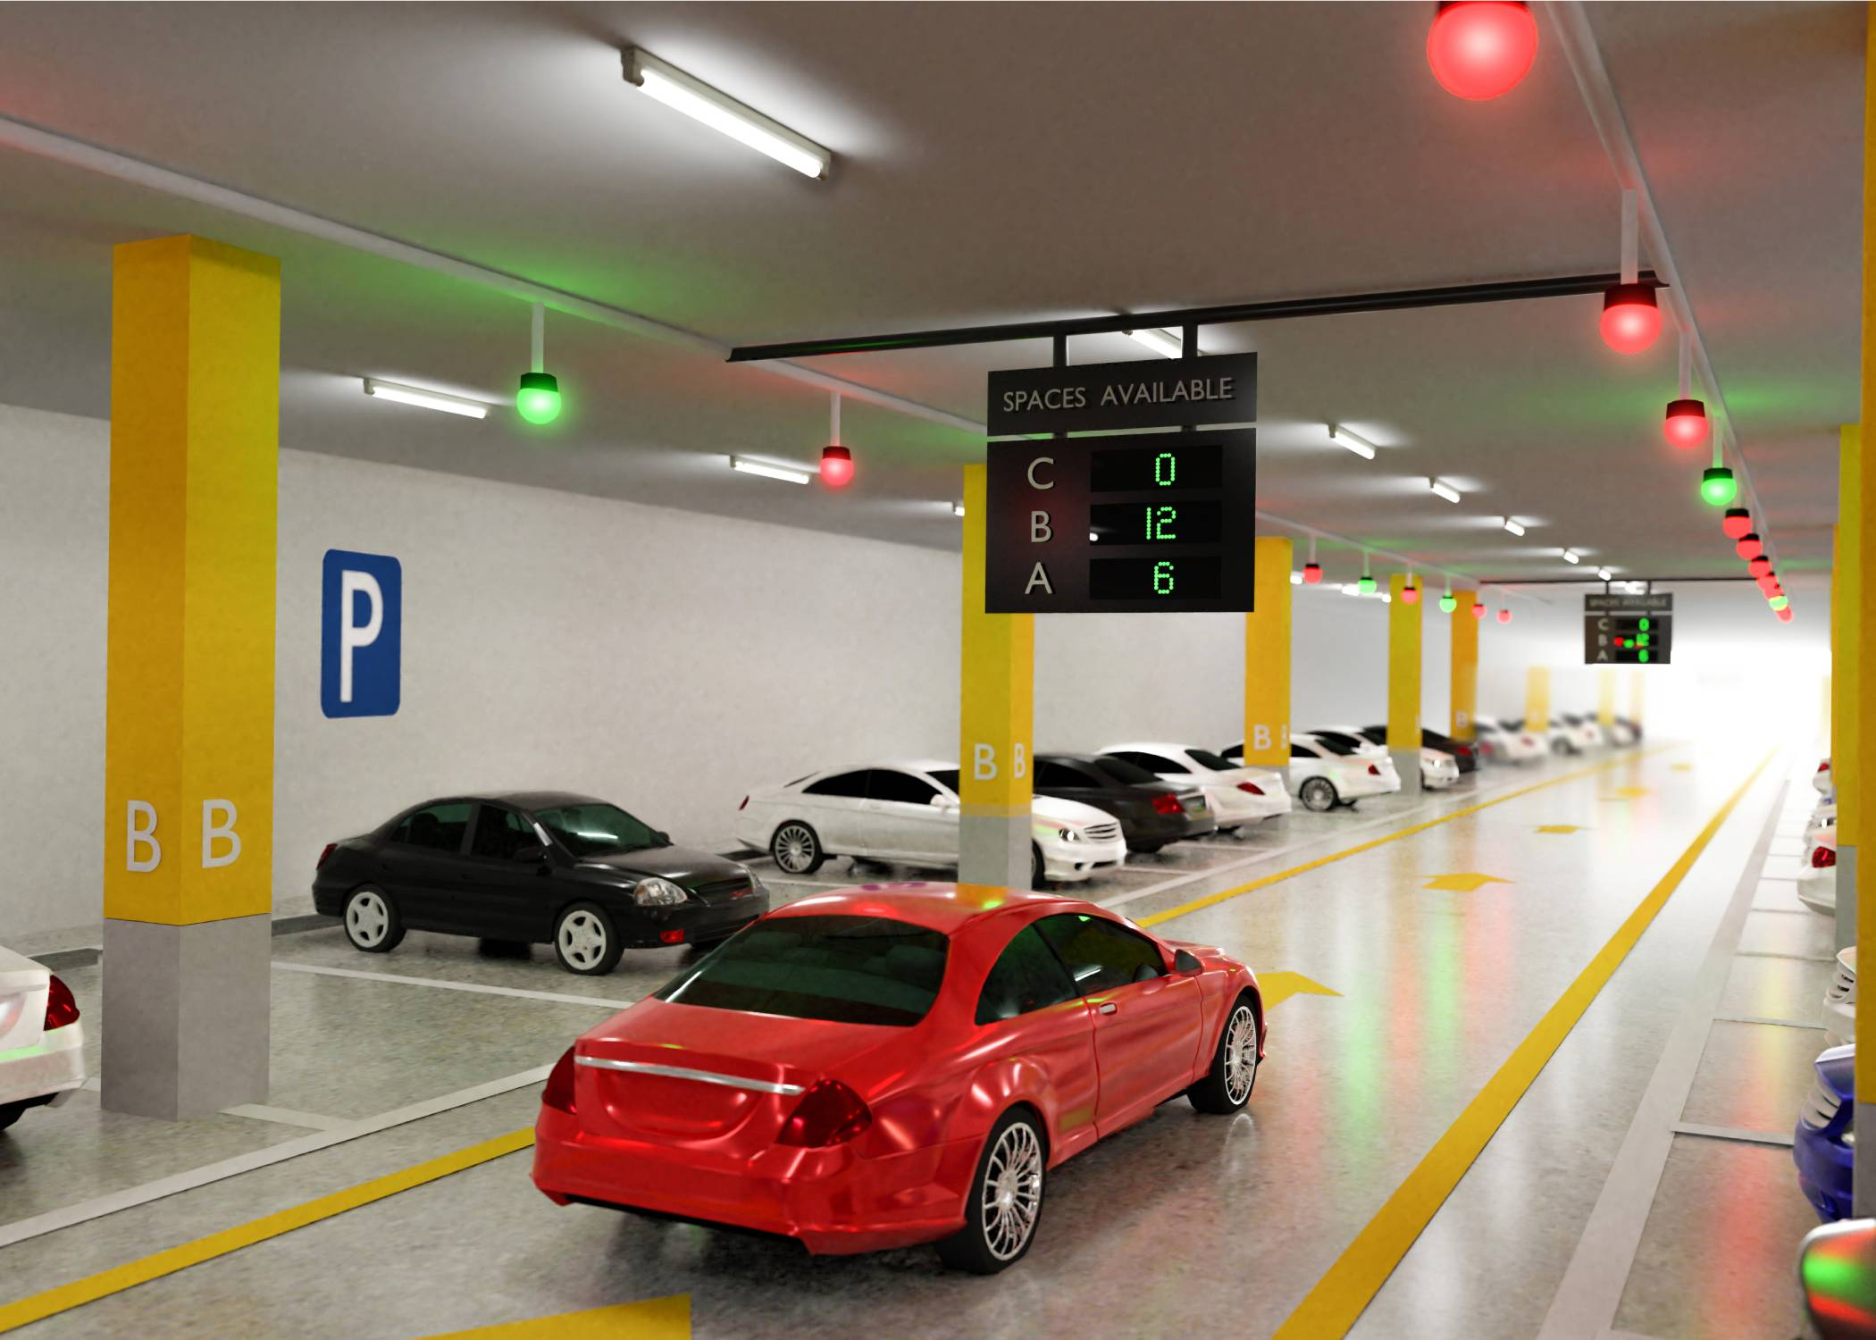

Index
Introduction
Problem
Solution
Sample display
Circuit design
Simulation
Benefits

Slide 3
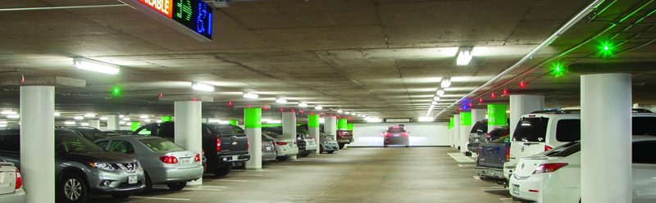
Introduction
In today’s scenario, finding an empty slot in a parking lot is a big issue, especially in metropolitan cities. So to make the parking process less tedious, we introduce our smart parking system.

Slide 4
Problem Statement
Niharika Singh, 21095078

Slide 5
Parking is one of the key component of transportation program all over the world. With the increasing percentage of vehicle ownership in recent times, parking has become a conflicting and confusing situation for lot of people.
The average automobile is in motion only for a small percentage of time. During the remaining times it is stationary, parked somewhere along the street or off the street on a parking lot or in a special parking facility.
Also finding an empty space to park our vehicle even in a parking lot is tedious.
In a multifloor parking, people have to roam around in every lane to find the right parking spot and then proceed to the next floor which is very time consuming and a great mood spoiler.
In densely populated regions like in metropolean cities, around metros, malls ,tourist places , factories etc , finding a parking slot in less time is still a dream.
In case of an emergency, exiting from parking is also a big issue
Niharika Singh, 21095078

Slide 6
Solution
Niharika Singh, 21095078

Slide 7
We introduce you to smart car parking system which helps you save time and energy.
In this we will use IR sensors in every parking slot which will tell us whether the slot is empty or occupied. We can also integrate it with red and green leds so that the user can see from far an empty slot.
We will have a big lcd display at the entrance which will guide the user to an empty slot by showing all the available (vacant) slots in each lane.
We have also used fire alarm sensors in case of emergency inside the parking lot .
In case of registered users, parking charges is automatically deducted from his/her account using RFID tag and a message will be sent to the person on his/her mobile phone via text sms.
For non registered users, manual mode of payment shall be adopted.

Slide 8
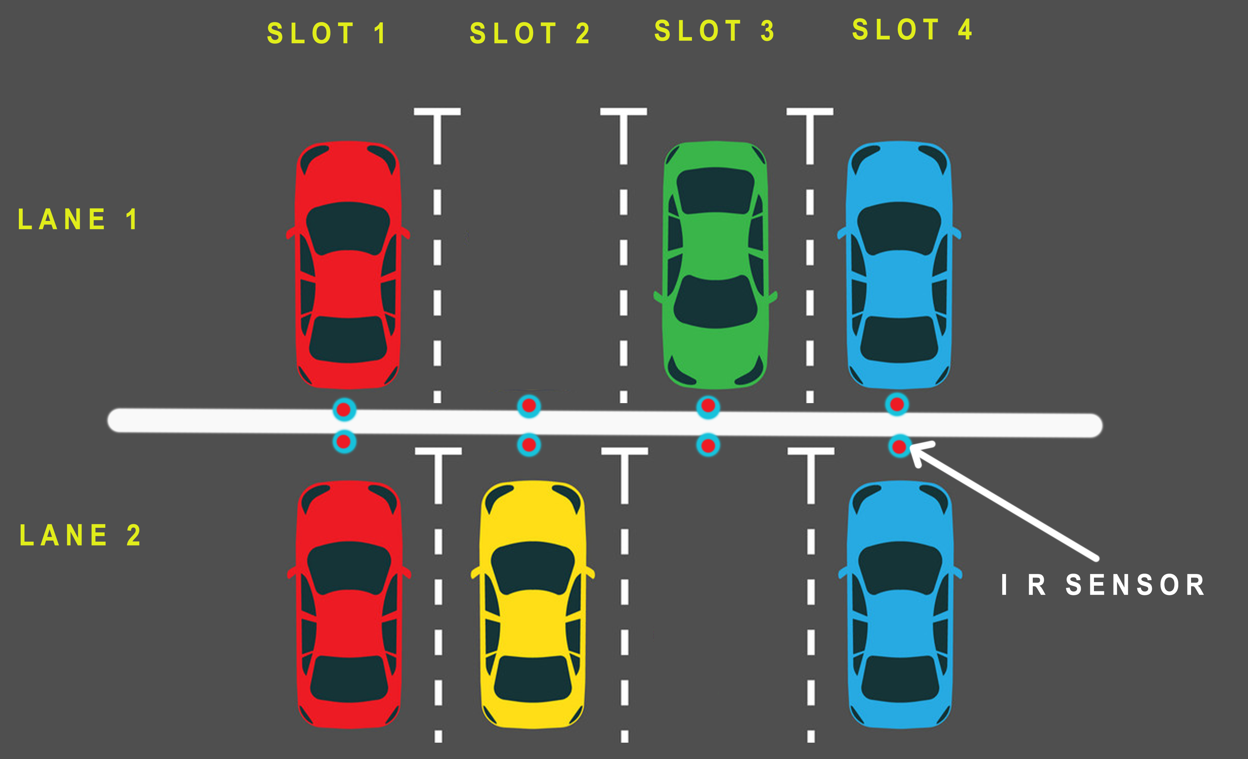
Sample parking example

Slide 9
Sample LCD display at the Entrance
 | Slot 1 | Slot 2 | Slot 3 | Slot 4
Lane 1 | O | V | O | O
Lane 2 | O | O | V | O
Lane 3 | V | O | V | O
Lane 4 | V | O | V | V
Total Vacancy
1
1
2
3
O : Occupied V: Vacant

Slide 10
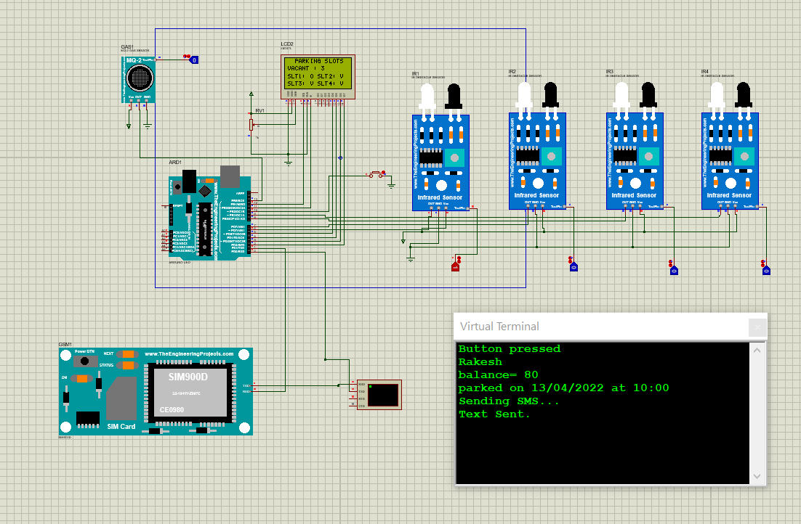
Circuit design showing Message Transmission

Slide 11
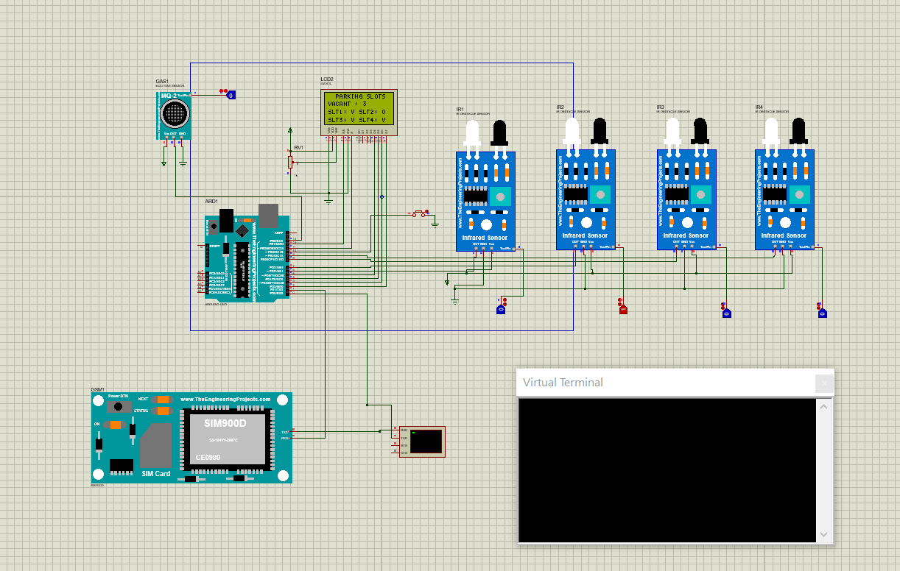
Circuit Design of IR sensor Functioning

Slide 12
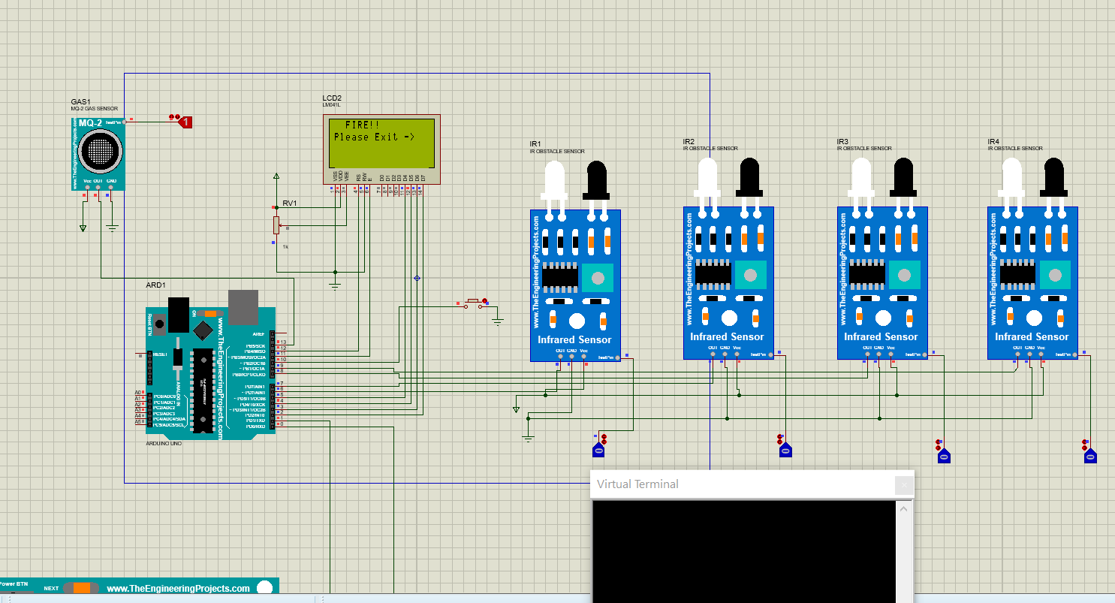
Circuit design showing Fire Alarm Functioning

Slide 13
In case we want to pre-book the slots, we can do it directly by using the application by contacting the authority. Updates regarding slot vacancies will be broadcasted to all the registered users so they don’t even need to check the slot availability at the entrance too.
I have used blynk web application and connected it with proteus using wifi. This will be operated by the parking authorities and then broadcast the message.
Please refer to following video

Slide 14
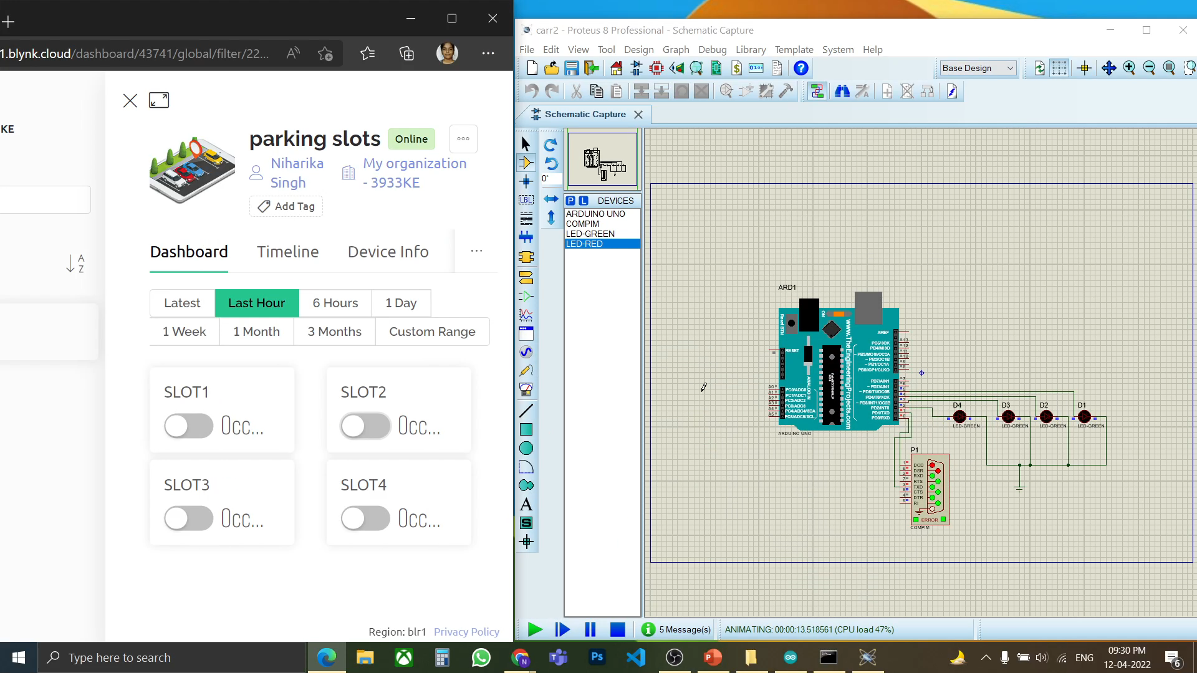

Slide 15
Benefits and future prospects
Time Save
Easy payment
Pollution control
Finding right space to park will be much easier.
More the automation of work, faster the work will get done
As slot finding will be easier, people can save their energy for more productive work
Also, our system will prove to be very efficient during emergency situations too.
Registered users wont have to stop to pay the fees, thus it will increase traffic flow.
For non registered users, we will have manual mode of payment too.
Pre-booking of slots is also available
People wont need to roam around to find empty parking slot, thus it will save fuel resource.
Waiting at the ticket counter will be less as many users would already have a RFID..
Thus, car fuel wastage can be minimized to a great extent.

Slide 16

Thank You
Niharika Singh
Ece fresher
niharika.singh.ece21@itbhu.ac.in

